Slide 1

Lead HeatScore – An AI + RAG Lead System
Project Guide:
Dr.D.Rosy Salomi Victoria
M.E.,Ph.D
Designation:
Professor
Name: SAKTHIDHARAN S(22IT091),
PHORVESHRAJ A(22IT072)
Year: IV year
Department: Information Technology

Slide 2
Introduction
Background of the research:
Financial markets have become highly complex due to globalization, digitalization, financial innovation, and the growing participation of institutional and retail investors.
Stock price movements exhibit nonlinear and irregular patterns, making traditional linear statistical models less effective for accurate forecasting.
Rapid information dissemination, geopolitical events, and macroeconomic uncertainties have significantly increased market volatility and unpredictability.
Economic events in one country quickly influence international markets, increasing cross-border risk transmission and forecasting challenges.
Algorithmic trading, high-frequency trading (HFT), and AI-driven automated systems have accelerated trading speed and volume, improving efficiency but also introducing systemic risks.

Slide 3
Research Problem Statement
Develop a deep learning–based system for accurate stock price forecasting using historical time-series data.
Address nonlinear patterns, volatility, and noise while handling large-scale, real-time financial datasets efficiently.
Integrate advanced models (LSTM, GRU, hybrid architectures) with techniques to reduce overfitting and improve generalization.
Incorporate model interpretability and provide risk analysis indicators such as volatility, confidence intervals, and trend strength.
Design an interactive dashboard to visualize historical data, predictions, performance metrics, and dynamic comparison scenarios.

Slide 4
Motivation and Significance
Motivation:
Analyze historical stock price data to identify hidden trends, seasonal patterns, and nonlinear relationships in financial markets.
Apply deep learning techniques, particularly a CNN–LSTM hybrid model, to capture complex spatial and temporal dependencies in time-series data.
Improve prediction accuracy by addressing volatility, noise, and irregular fluctuations in dynamic market environments.
Develop a robust AI-driven framework capable of handling large-scale, high-dimensional financial datasets efficiently.
Advances Provide a reliable data-driven forecasting system that supports smarter investment decisions and bridges theoretical research with practical financial applications.

Slide 5
Literature Review
Overview of Existing Works:
Numerous research studies have applied machine learning and deep learning techniques for stock market forecasting.
Early prediction models were primarily based on traditional statistical and rule-based approaches.
Technical indicators such as Moving Averages (MA), RSI, and MACD were widely used to analyze historical price trends.
These conventional models mainly focused on linear relationships and struggled to capture complex nonlinear market patterns or adapt to dynamic conditions.
Due to inconsistent accuracy during high volatility periods, there arose a need for more advanced machine learning and deep learning–based forecasting models.

Slide 6
Research Gap Identification:
Most existing AI-based trading systems function as black-box models, lacking
Interpretability and reducing transparency and user trust.
Lack Current visualization dashboards are often static and do not provide interactive,
exploratory, or customizable analytical features.
Many systems fail to include advanced analytical insights such as confidence levels,
uncertainty ranges, volatility metrics, and risk indicators.
Existing models primarily rely on historical price data, with limited integration of technical,
fundamental, and sentiment-based financial information.
The absence of unified frameworks combining prediction, explainability, risk analysis, and
visualization highlights the need for a transparent and interactive deep learning–based stock
forecasting system.

Slide 7
Key Findings from Past Studies
AI-based trading systems generally outperform manual trading strategies by leveraging large-scale historical financial data and advanced machine learning techniques.
Deep learning models, particularly LSTM networks, effectively capture long-term dependencies and nonlinear patterns in time-series stock data.
Hybrid architectures such as CNN–LSTM enhance feature extraction and temporal learning, improving overall prediction performance.
Automated and algorithmic trading systems reduce emotional bias, improve execution speed, and efficiently process vast amounts of structured and unstructured financial data.
Although prediction accuracy has improved, there remains a need for greater interpretability, transparency, and robustness in AI-based forecasting systems.

Slide 8
Research Objectives
Design and develop an AI-based stock price prediction system using a CNN–LSTM deep learning architecture for accurate future price forecasting.
Analyze historical OHLCV data to identify meaningful patterns and compare the proposed model with traditional and standalone models such as ARIMA, SVR, CNN, and LSTM.
Evaluate model performance using standard metrics including RMSE, MAE, MAPE, and Directional Accuracy.
Assess the system’s capability to provide reliable future price forecasts to support informed investment decisions.
Deliver an accurate and reliable prediction framework with clear visual insights and improved forecasting performance for data-driven financial analysis.

Slide 9
Methodology
The proposed system utilizes both historical and real-time financial market data for comprehensive analysis and model training.
Historical market data includes OHLCV (Open, High, Low, Close, Volume) along with timestamp information collected from stock performance records.
Real-time data consists of live price feeds obtained through broker or market APIs to support dynamic trading decisions.
The methodology follows a modular AI-driven framework beginning with a Data Collection Module that gathers historical and live data.
A Data Preprocessing Module cleans the data, removes noise, normalizes values, and generates relevant technical indicators for model input.

Slide 10
Implementation Details
Programming Language:
Python
Machine Learning Libraries:
NumPy
Pandas
yfinance - for stock data collection
Deep Learning Framework:
TensorFlow(keras API)
Frontend:
Streamlit
Backend:
FastAPI

Slide 11
Results
Key Findings (with Graphs / Tables / Visualizations)
The performance of the proposed CNN–LSTM–based stock price prediction model was evaluated using historical INFY stock data, with the test period spanning 2025–2026.
The experimental results indicate that the hybrid CNN–LSTM model consistently outperformed traditional and standalone models, including ARIMA, SVR, CNN, and LSTM, across all evaluation metrics.Time-series prediction models (such as LSTM) showed improved accuracy in identifying market trends.
The analysis dashboard successfully visualized:
Real-time profit and loss
Trade entry and exit points
Strategy-wise performance
Risk metrics such as drawdown and win rate

Slide 12
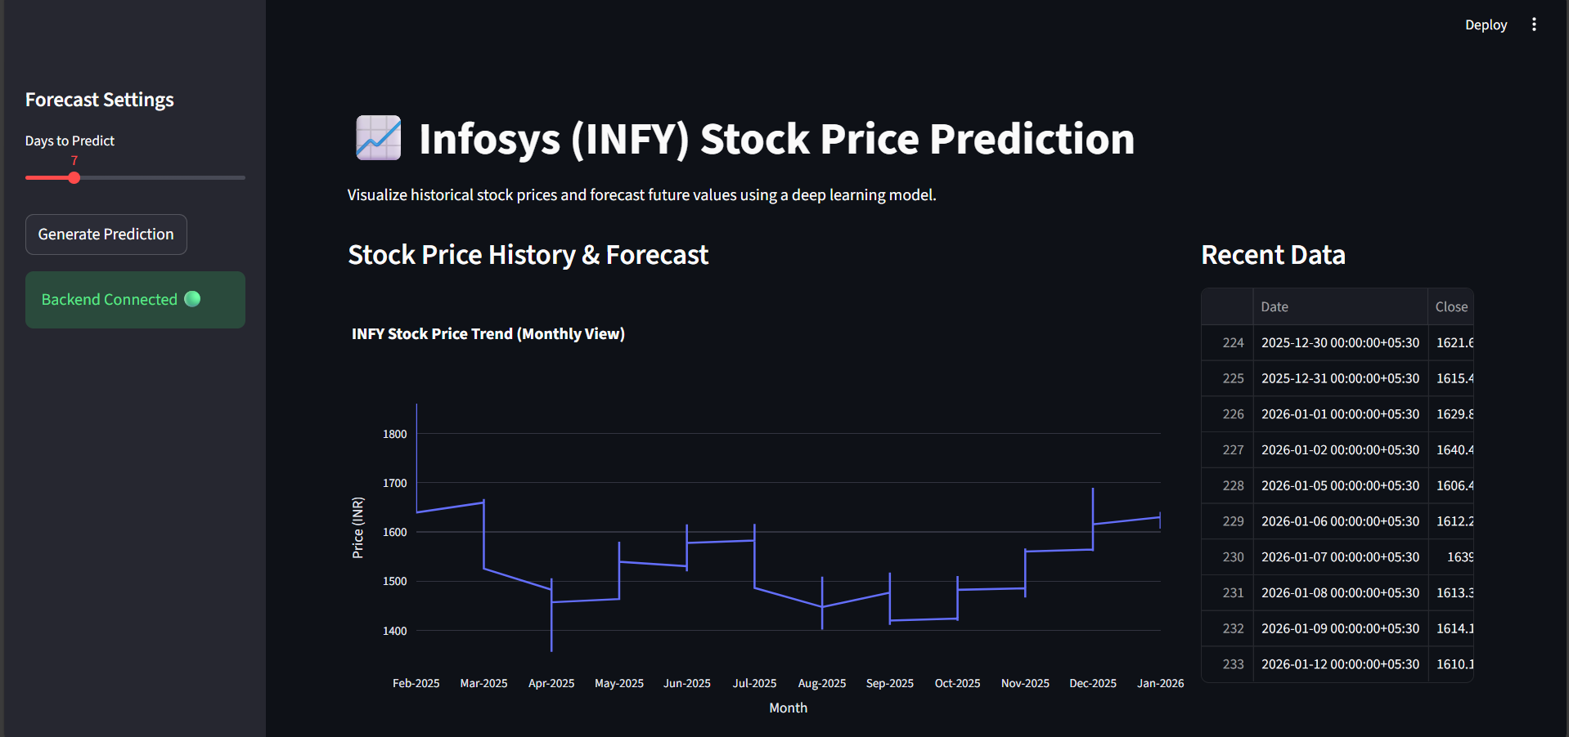
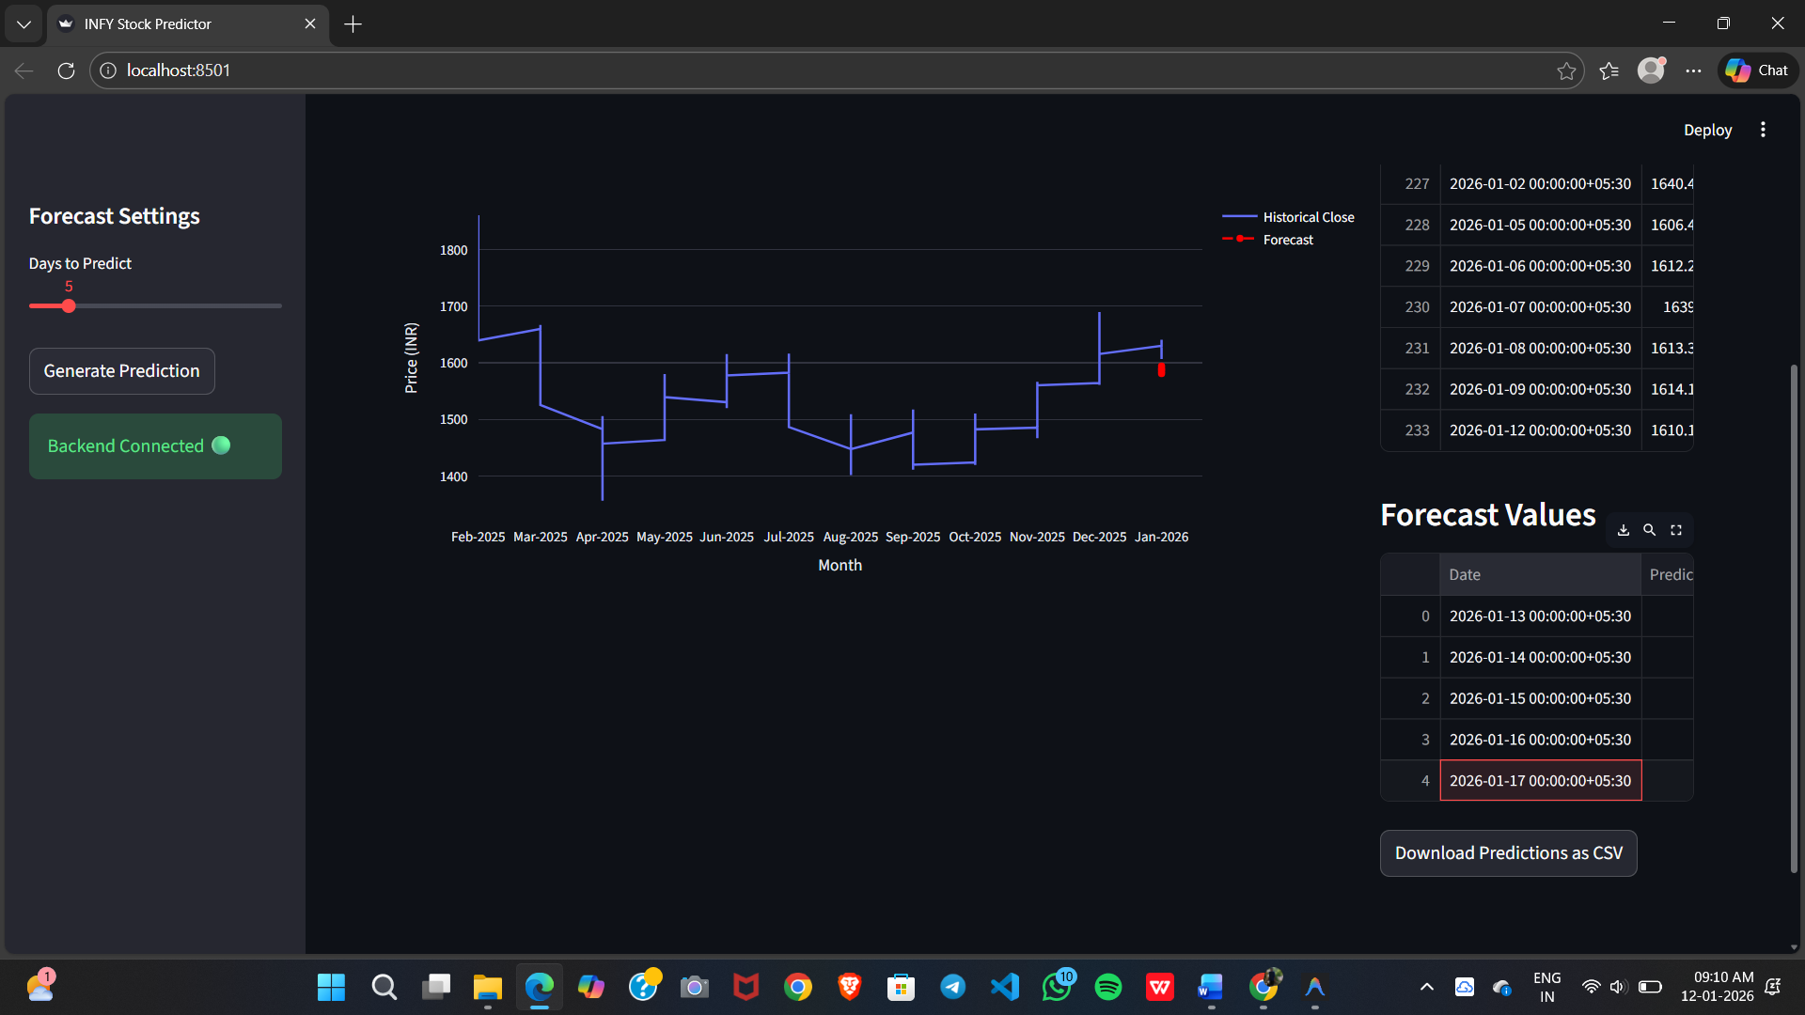
Screenshots

Slide 13
Limitations:
The model’s performance heavily depends on the quality, accuracy, and volume of historical stock data. Noisy, incomplete, or insufficient data can significantly reduce prediction accuracy and generalization capability.
Extreme events such as economic crises, policy changes, geopolitical conflicts, or unexpected corporate announcements (black swan events) can drastically affect market behavior, making predictions less reliable.
The system mainly relies on historical time-series data and does not fully incorporate real-time external factors like news sentiment or social media analysis, limiting contextual awareness.
There is a risk of overfitting if the model is not properly tuned and validated. Additionally, periodic retraining is required to adapt to changing market conditions.

Slide 14
Future Research Directions
Integration of advanced deep learning models (e.g., Transformers) for improved temporal feature learning
Adoption of Reinforcement Learning for adaptive trading strategies
Incorporation of real-time news and sentiment analysis for contextual market understanding
Extension to multi-stock, portfolio, and sector-level prediction models
Implementation of explainable AI, risk management, and scalable real-time deployment frameworks

Slide 15
Conclusion
Successfully designed and implemented a hybrid CNN–LSTM–based stock price prediction
system for forecasting INFY stock prices using historical time-series data.
Developed an integrated deep learning architecture combining CNN for short-term feature
extraction and LSTM for long-term trend modeling, improving prediction accuracy.
Applied advanced preprocessing techniques and evaluation metrics (MSE, RMSE) to ensure
reliable and effective model performance on complex financial data.
Demonstrated the capability of hybrid deep learning models to capture nonlinear market
patterns and provide practical AI-driven forecasting solutions.
Provided a scalable and extensible framework that bridges deep learning research with
intelligent financial decision-support systems.

Slide 16
References
[1)ZReddy, P., et al. (2024). Mesas, M. B. (2025). Investigation of fore- casting model designed to evaluate financial trends (Doctoral dissertation, Kauno technologist universitates.). Applied Soft Computing, 152, 111234.
https://doi.org/10.1016/j.asoc.2023.111234
2)Zhang, W., et al. (2025). Ramos, F., Silva, G., Luz, E., Silva, P. (2023, September). Enhancing Stock Market Predictions Through the Integration of Convolutional and Recursive LSTM Blocks: A Cross- market Analysis. In Brazilian Conference on Intelligent Systems (pp. 92- 106). Cham: Springer Nature Switzerland. International Journal of Fore- casting, 41(1), 210–225. https://doi.org/10.1016/j.ijforecast.2024.06.003
3)Gupta, A., et al. (2025). Singh, P., Jha, M., Sharaf, M., El-Meling, M. A., Gadek Allu, T. R. (2023). Harnessing a hybrid CNN-LSTM model for portfolio performance: A case study on stock selection and optimization. Ieee Access, 11, 104000-104015. Quantitative Finance, 25(2), 301–318. https://doi.org/10.1080/14697688.2024.2401234
4)Wang, L., et al. (2025). Patel, N., Vasani, N., Jadav, N. K., Gupta, R., Tanwar, S., Polkowski, Z., ... Gafar, A. (2023). F-LSTM: Federated learning-based LSTM framework for cryptocurrency price prediction. Electronic Research Archive, 31(10). ACM Transactions on Intelligent Systems and Technology, 16(1), Article 12. https://doi.org/10.1145/ 3638521

Slide 17
Q&A
Thank you!

